Slide 1

Statistics for Business and Economics (13e)
Slides by
John
Loucks
St. Edward’s
University
Anderson, Sweeney, Williams, Camm, Cochran
© 2017 Cengage Learning
Slides by John Loucks
St. Edwards University

Slide 2





















Chapter 9 Hypothesis Testing
Developing Null and Alternative Hypotheses
Type I and Type II Errors
Population Mean: σ Known
Population Mean: σ Unknown
Population Proportion

Slide 3
Hypothesis Testing
Hypothesis testing can be used to determine whether a statement about the value of a population parameter should or should not be rejected.
The null hypothesis, denoted by H₀ , is a tentative assumption about a population parameter.
The alternative hypothesis, denoted by H_{a}, is the opposite of what is stated in the null hypothesis.
The hypothesis testing procedure uses data from a sample to test the two competing statements indicated by H₀ and H_{a}.

Slide 4
Developing Null and Alternative Hypotheses
It is not always obvious how the null and alternative hypotheses should be formulated.
Care must be taken to structure the hypotheses appropriately so that the test conclusion provides the information the researcher wants.
The context of the situation is very important in determining how the hypotheses should be stated.
In some cases it is easier to identify the alternative hypothesis first. In other cases the null is easier.
Correct hypothesis formulation will take practice.

Slide 5
Developing Null and Alternative Hypotheses
Alternative Hypothesis as a Research Hypothesis
Many applications of hypothesis testing involve an attempt to gather evidence in support of a research hypothesis.
In such cases, it is often best to begin with the alternative hypothesis and make it the conclusion that the researcher hopes to support.
The conclusion that the research hypothesis is true is made if the sample data provides sufficient evidence to show that the null hypothesis can be rejected.

Slide 6
Developing Null and Alternative Hypotheses
Alternative Hypothesis as a Research Hypothesis
Example:
A new teaching method is developed that is believed to be better than the current method.
Alternative Hypothesis:
The new teaching method is better.
Null Hypothesis:
The new method is no better than the old method.

Slide 7
Developing Null and Alternative Hypotheses
Alternative Hypothesis as a Research Hypothesis
Example:
A new sales force bonus plan is developed in an attempt to increase sales.
Alternative Hypothesis:
The new bonus plan will increase sales.
Null Hypothesis:
The new bonus plan will not increase sales.

Slide 8
Developing Null and Alternative Hypotheses
Alternative Hypothesis as a Research Hypothesis
Example:
A new drug is developed with the goal of lowering blood pressure more than the existing drug.
Alternative Hypothesis:
The new drug lowers blood pressure more than the existing drug.
Null Hypothesis:
The new drug does not lower blood pressure more than the existing drug.

Slide 9
Developing Null and Alternative Hypotheses
Null Hypothesis as an Assumption to be Challenged
We might begin with a belief or assumption that a statement about the value of a population parameter is true.
We then use a hypothesis test to challenge the assumption and determine if there is statistical evidence to conclude that the assumption is incorrect.
In these situations, it is helpful to develop the null hypothesis first.

Slide 10
Developing Null and Alternative Hypotheses
Null Hypothesis as an Assumption to be Challenged
Example:
The label on a soft drink bottle states that it contains 67.6 fluid ounces.
Null Hypothesis:
The label is correct. μ > 67.6 ounces.
Alternative Hypothesis:
The label is incorrect. μ < 67.6 ounces.

Slide 11



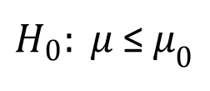







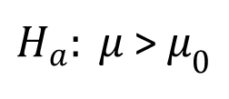

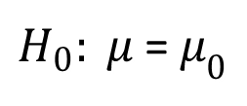






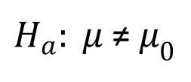


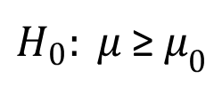






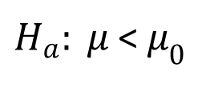


Summary of Forms for Null and Alternative Hypotheses
The equality part of the hypotheses always appears in the null hypothesis.
In general, a hypothesis test about the value of a population mean μ must take one of the following three forms (where μ₀ is the hypothesized value of the population mean).
$H_{0}: μ$≥$μ_{0}$
$H_{0}: μ$≤$μ_{0}$
$H_{0}: μ$=$μ_{0}$
$H_{a}: μ$<$μ_{0}$
$H_{a}: μ$>$μ_{0}$
$H_{a}: μ$≠$μ_{0}$
One-tailed
(lower-tail)
One-tailed
(upper-tail)
Two-tailed

Slide 12
Null and Alternative Hypotheses
Example: Metro EMS
A major west coast city provides one of the most comprehensive emergency medical services in the world. Operating in a multiple hospital system with approximately 20 mobile medical units, the service goal is to respond to medical emergencies with a mean time of 12 minutes or less.
The director of medical services wants to formulate a hypothesis test that could use a sample of emergency response times to determine whether or not the service goal of 12 minutes or less is being achieved.

Slide 13
Null and Alternative Hypotheses
H₀: μ < 12
The emergency service is meeting the response goal; no follow-up action is necessary.
H_{a}: μ > 12
The emergency service is not meeting the response goal; appropriate follow-up action is necessary.
where: μ = mean response time for the population
of medical emergency requests

Slide 14
Problems
1, 2, 3 edition page
11e 353
12e 387
13e 392
14e 422

Slide 15
1. a. H₀: μ ≤ 600 Manager’s claim.
H_{a}: μ > 600
b. We are not able to conclude that the manager’s claim is wrong.
c. The manager’s claim can be rejected. We can conclude that μ > 600

Slide 16
2. a. H₀: μ ≤ 14
H_{a}: μ > 14 Research hypothesis
b. There is no statistical evidence that the new bonus plan increases sales volume.
c. The research hypothesis that μ > 14 is supported. We can conclude that the new bonus plan increases the mean sales volume.

Slide 17
3. a. H₀: μ = 32 Specified filling weight
H_{a}: μ ≠ 32 Overfilling or underfilling exists
b. There is no evidence that the production line is not operating properly. Allow the production process to continue.
c. Conclude μ ≠ 32 and that overfilling or underfilling exists. Shut down and adjust the production line.

Slide 18
Type I Error
Because hypothesis tests are based on sample data, we must allow for the possibility of errors.
A Type I error is rejecting H₀ when it is true.
The probability of making a Type I error when the null hypothesis is true as an equality is called the level of significance.
Applications of hypothesis testing that only control for the Type I error are often called significance tests.

Slide 19
Type II Error
A Type II error is accepting H₀ when it is false.
It is difficult to control for the probability of making a Type II error.
Statisticians avoid the risk of making a Type II error by using “do not reject H₀” and not “accept H₀”.

Slide 20
Type I and Type II Errors
Population Condition
H₀ True
(μ < 12)
H₀ False
(μ > 12)
Conclusion
Accept H₀
(Conclude μ < 12)
Correct
Conclusion
Type II Error
Reject H₀
(Conclude μ > 12)
Type I Error
Correct
Conclusion

Slide 21
Problem
7 Edition page
11e 356
12e 390
13e 395
14e 424

Slide 22
7. a. H₀: μ ≤ 8000
H_{a}: μ > 8000 Research hypothesis to see if the plan increases average sales.
b. Claiming μ > 8000 when the plan does not increase sales. A mistake could be implementing the plan when it does not help.
c. Concluding μ ≤ 8000 when the plan really would increase sales. This could lead to not implementing a plan that would increase sales.

Slide 23
p-Value Approach to One-Tailed Hypothesis Testing
The p-value is the probability, computed using the test statistic, that measures the support (or lack of support) provided by the sample for the null hypothesis.
If the p-value is less than or equal to the level of significance α, the value of the test statistic is in the rejection region.
Reject H₀ if the p-value < α .

Slide 24
Suggested Guidelines for Interpreting p-Values
Less than .01
Overwhelming evidence to conclude H_{a} is true.
Between .01 and .05
Strong evidence to conclude H_{a} is true.
Between .05 and .10
Weak evidence to conclude H_{a} is true.
Greater than .10
Insufficient evidence to conclude H_{a} is true.

Slide 25
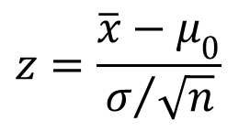
Lower-Tailed Test About a Population Mean: σ Known
p-Value Approach
Sampling
Distribution of
α = .10
$$z=\frac{\overline{x}−μ_{0}}{σ/{\sqrt{n}}}$$
p-value
= .0721
p-Value < α ,
so reject H₀.
z
z =
-1.46
z_{α} =
-1.28
0

Slide 26

Upper-Tailed Test About a Population Mean: σ Known
p-Value Approach
Sampling
Distribution of
α = .04
$$z=\frac{\overline{x}−μ_{0}}{σ/{\sqrt{n}}}$$
p-Value
= .011
(p-Value < α ,
so reject H₀.)
z
0
z_{α} =
1.75
z =
2.29

Slide 27
Critical Value Approach to One-Tailed Hypothesis Testing
The test statistic z has a standard normal probability distribution.
We can use the standard normal probability distribution table to find the z-value with an area of α in the lower (or upper) tail of the distribution.
The value of the test statistic that established the boundary of the rejection region is called the critical value for the test.
The rejection rule is:
Lower tail: Reject H₀ if -Zcalc < -z_{α}
Upper tail: Reject H₀ if Zcalc > z_{α}

Slide 28
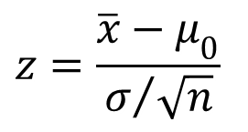
Lower-Tailed Test About a Population Mean: σ Known
Critical Value Approach
Sampling
Distribution of
$$z=\frac{\overline{x}−μ_{0}}{σ/{\sqrt{n}}}$$
Reject H₀
α = .10
Do Not Reject H₀
z
-z_{α} = -1.28
0

Slide 29

Upper-Tailed Test About a Population Mean: σ Known
Critical Value Approach
Sampling
Distribution of
$$z=\frac{\overline{x}−μ_{0}}{σ/{\sqrt{n}}}$$
Reject H₀
α = .05
Do Not Reject H₀
z
0
z_{α} = 1.645

Slide 30
















































Steps of Hypothesis Testing
Step 1. Develop the null and alternative hypotheses.
Step 2. Specify the level of significance α.
Step 3. Collect the sample data and compute the value of the test statistic.
p-Value Approach
Step 4. Use the value of the test statistic to compute the p-value.
Step 5. Reject H₀ if p-value < α.

Slide 31























Steps of Hypothesis Testing
Critical Value Approach
Step 4. Use the level of significance α to determine the critical value and the rejection rule.
Step 5. Use the value of the test statistic and the rejection rule to determine whether to reject H₀.

Slide 32
One-Tailed Tests About a Population Mean: σ Known
Example: Metro EMS
The response times for a random sample of 40 medical emergencies were tabulated. The sample mean is 13.25 minutes. The population standard
deviation is believed to be 3.2 minutes.
The EMS director wants to perform a hypothesis test, with a .05 level of significance, to determine whether the service goal of 12 minutes or less is being achieved.

Slide 33























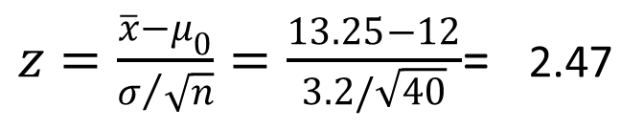




One-Tailed Tests About a Population Mean: σ Known
p -Value and Critical Value Approaches
1. Develop the hypotheses.
H₀: μ < 12
H_{a}: μ > 12
2. Specify the level of significance.
α = .05
3. Compute the value of the test statistic.
$z=\frac{\overline{x}−μ_{0}}{σ/{\sqrt{n}}}=\frac{13.25−12}{3.2/\sqrt{40}}$= 2.47

Slide 34











One-Tailed Tests About a Population Mean: σ Known
p –Value Approach
4. Compute the p –value.
For z = 2.47, cumulative probability = .9932.
p-value = 1 - .9932 = .0068
5. Determine whether to reject H₀.
Because p-value = .0068 < α = .05, we reject H₀.
There is sufficient statistical evidence to infer that Metro EMS is not meeting the response goal of 12 minutes.

Slide 35

One-Tailed Tests About a Population Mean: σ Known
p –Value Approach
Sampling
Distribution of
α = .05
$$z=\frac{\overline{x}−μ_{0}}{σ/{\sqrt{n}}}$$
p-value
= .0068
(p-Value < α,
so reject H₀.)
z
0
z_{α} =
1.645
z =
2.47

Slide 36
One-Tailed Tests About a Population Mean: σ Known
Critical Value Approach
4. Determine the critical value and rejection rule.
For α = .05, z_{.05} = 1.645
Reject H₀ if Zcalc > 1.645
5. Determine whether to reject H₀.
Because 2.47 > 1.645, we reject H₀.
There is sufficient statistical evidence to infer that Metro EMS is not meeting the response goal of 12 minutes.

Slide 37
p-Value Approach to Two-Tailed Hypothesis Testing
Compute the p-value using the following three steps:
1. Compute the value of the test statistic z.
2. If z is in the upper tail (z > 0), compute the probability that z is greater than or equal to the value of the test statistic. If z is in the lower tail (z < 0), compute the probability that z is less than or equal to the value of the test statistic.
3. Double the tail area obtained in step 2 to obtain the p-value.
The rejection rule: Reject H₀ if the p-value < α .

Slide 38
Critical Value Approach to Two-Tailed Hypothesis Testing
The critical values will occur in both the lower and upper tails of the standard normal curve.
Use the standard normal probability distribution table to find z_{α/2} (the z-value with an area of α/2 in the upper tail of the distribution).
The rejection rule is: Reject H₀ if -Zcalc < -z_{α/2} or Zcalc > z_{α/2}.

Slide 39
Two-Tailed Tests About a Population Mean: σ Known
Example: Glow Toothpaste
The production line for Glow toothpaste is designed to fill tubes with a mean weight of 6 oz. Periodically, a sample of 30 tubes will be selected in order to check the filling process.
Quality assurance procedures call for the continuation of the filling process if the sample results are consistent with the assumption that the mean filling weight for the population of toothpaste tubes is 6 oz.; otherwise the process will be adjusted.

Slide 40
Two-Tailed Tests About a Population Mean: σ Known
Example: Glow Toothpaste
Assume that a sample of 30 toothpaste tubes provides a sample mean of 6.1 oz. The population standard deviation is believed to be 0.2 oz.
Perform a hypothesis test, at the .03 level of significance, to help determine whether the filling process should continue operating or be stopped and corrected.

Slide 41
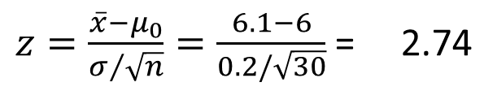
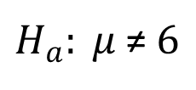
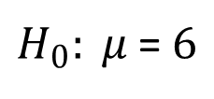
Two-Tailed Tests About a Population Mean: σ Known
p –Value and Critical Value Approaches
1. Determine the hypotheses.
$H_{0}: μ$=$6$
$H_{a}: μ$≠$6$
2. Specify the level of significance.
α = .03
3. Compute the value of the test statistic.
$z=\frac{\overline{x}−μ_{0}}{σ/{\sqrt{n}}}=\frac{6.1−6}{0.2/\sqrt{30}}$ = 2.74

Slide 42













Two-Tailed Tests About a Population Mean: σ Known
p –Value Approach
4. Compute the p –value.
For z = 2.74, cumulative probability = .9969
p-value = 2(1 - .9969) = .0062
5. Determine whether to reject H₀.
Because p-value = .0062 < α = .03, we reject H₀.
There is sufficient statistical evidence to infer that the alternative hypothesis is true (i.e. the mean filling weight is not 6 ounces).

Slide 43
Two-Tailed Tests About a Population Mean: σ Known
p-Value Approach
1/2
p-value
= .0031
1/2
p-value
= .0031
α/2 =
.015
α/2 =
.015
z
z = -2.74
0
z = 2.74
-z_{α/2} = -2.17
z_{α/2} = 2.17

Slide 44























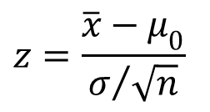















Two-Tailed Tests About a Population Mean: σ Known
Critical Value Approach
Sampling
Distribution of
$$z=\frac{\overline{x}−μ_{0}}{σ/{\sqrt{n}}}$$
Reject H₀
Reject H₀
α/2 = .015
α/2 = .015
Do Not Reject H₀
z
-2.17
0
2.17

Slide 45
Two-Tailed Tests About a Population Mean: σ Known
Critical Value Approach
4. Determine the critical value and rejection rule.
For α/2 = .03/2 = .015, z_{.015} = 2.17
Reject H₀ if z < -2.17 or z > 2.17
5. Determine whether to reject H₀.
Because 2.74 > 2.17, we reject H₀.
There is sufficient statistical evidence to infer that the alternative hypothesis is true (i.e. the mean filling weight is not 6 ounces).

Slide 46
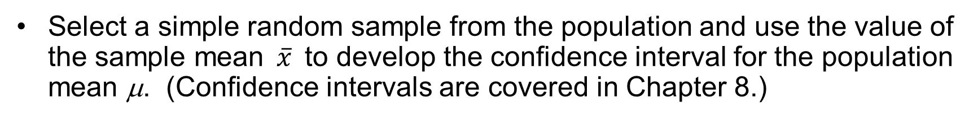
Confidence Interval Approach to Two-Tailed Tests About a Population Mean
Select a simple random sample from the population and use the value of the sample mean$\overline{x}$to develop the confidence interval for the population mean μ. (Confidence intervals are covered in Chapter 8.)
If the confidence interval contains the hypothesized value μ₀, do not reject H₀. Otherwise, reject H₀. (Actually, H₀ should be rejected if μ₀ happens to be equal to one of the end points of the confidence interval.)

Slide 47
Filling weight of the tubes should measure 6 Oz. If the sample average is 6.1, at 97 percent Conf. Interval, do you accept or Reject H0? St.Dev = 0.2 and n=30.
H0:µ = µ0
Ha:µ ≠ µ0

Slide 48
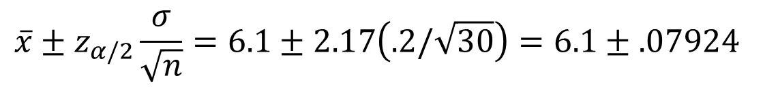
Confidence Interval Approach to Two-Tailed Tests About a Population Mean
The 97% confidence interval for μ is
$$\overline{x}±z_{α/2}\frac{σ}{\sqrt{n}}=6.1±2.17\left(.2/\sqrt{30}\right)=6.1±.07924$$
or 6.02076 to 6.17924
Because the hypothesized value for the population mean, μ₀ = 6, is not in this interval, the hypothesis-testing conclusion is that the null hypothesis, H₀: μ = 6, can be rejected.

Slide 49
Problems
9, 10, 11 edition page
11e 367
12e 402
13e 407
14e 436

Slide 50
















9. a.
b. Lower tail p-value is the area to the left of the test statistic
Using normal table with z = -2.12: p-value =.0170
c. p-value ≤ .05, reject H₀
d. Reject H₀ if z ≤ -1.645
-2.12 ≤ -1.645, reject H₀

Slide 51





























10. a.
b. Upper tail p-value is the area to the right of the test statistic
Using normal table with z = 1.48: p-value = 1.0000 - .9306 = .0694
c. p-value > .01, do not reject H₀
d. Reject H₀ if z ≥ 2.33
1.48 < 2.33, do not reject H₀

Slide 52





























11. a.
b. Because z < 0, p-value is two times the lower tail area
Using normal table with z = -2.00: p-value = 2(.0228) = .0456
c. p-value ≤ .05, reject H₀
d. Reject H₀ if z ≤ -1.96 or z ≥ 1.96
-2.00 ≤ -1.96, reject H₀

Slide 53
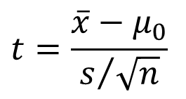
Tests About a Population Mean: σ Unknown
Test Statistic:
$$t=\frac{\overline{x}−μ_{0}}{s/{\sqrt{n}}}$$
This test statistic has a t distribution with n - 1 degrees of freedom.

Slide 54
Tests About a Population Mean: σ Unknown
Rejection Rule: p -Value Approach
Reject H₀ if p –value < α
Rejection Rule: Critical Value Approach
H₀: μ > μ₀
Reject H₀ if -tcalc < -t_{α}
H₀: μ < μ₀
Reject H₀ if tcalc > t_{α}
H₀: μ = μ₀
Reject H₀ if -tcalc < - t_{α/2} or tcalc > t_{α/2}

Slide 55
p -Values and the t Distribution
The format of the t distribution table provided in most statistics textbooks does not have sufficient detail to determine the exact p-value for a hypothesis test.
However, we can still use the t distribution table to identify a range for the p-value.
An advantage of computer software packages is that the computer output will provide the p-value for the t distribution.

Slide 56
Example: Highway Patrol
One-Tailed Test About a Population Mean: σ Unknown
A State Highway Patrol periodically samples vehicle speeds at various locations on a particular roadway. The sample of vehicle speeds is used to
test the hypothesis H₀: μ < 65.
The locations where H₀ is rejected are deemed the best locations for radar traps. At Location F, a sample of 64 vehicles shows a mean speed of 66.2 mph with a standard deviation of 4.2 mph. Use α = .05 to test the hypothesis.

Slide 57
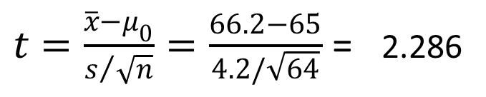
One-Tailed Test About a Population Mean: σ Unknown
p –Value and Critical Value Approaches
1. Determine the hypotheses.
H₀: μ < 65
H_{a}: μ > 65
2. Specify the level of significance.
α = .05
3. Compute the value of the test statistic.
$t=\frac{\overline{x}−μ_{0}}{s/{\sqrt{n}}}=\frac{66.2−65}{4.2/\sqrt{64}}$ = 2.286

Slide 58
One-Tailed Test About a Population Mean: σ Unknown
p –Value Approach
4. Compute the p –value.
For t = 2.286, the p-value must be less than .025
(for t = 1.998) and greater than .01 (for t = 2.387).
.01 < p–value < .025
5. Determine whether to reject H₀.
Because p-value < α = .05, we reject H₀.
We are at least 95% confident that the mean speed of vehicles at Location F is greater than 65 mph.

Slide 59
One-Tailed Test About a Population Mean: σ Unknown
Critical Value Approach
4. Determine the critical value and rejection rule.
For α = .05 and d.f. = 64 – 1 = 63, t_{.05} = 1.669
Reject H₀ if t > 1.669
5. Determine whether to reject H₀.
Because 2.286 > 1.669, we reject H₀.
We are at least 95% confident that the mean speed of vehicles at Location F is greater than 65 mph. Location F is a good candidate for a radar trap.

Slide 60
One-Tailed Test About a Population Mean: σ Unknown
Reject H₀
(α = .05)
Do Not Reject H₀
p-value
< .025
(p-Value < α ,
so reject H₀.)
t
0
t_{α} =
1.669
t =
2.286

Slide 61
Problems
23, 28, 32 edition page
11e 374
12e 409
13e 413
14e 443

Slide 62











23. a.
b. Degrees of freedom = n – 1 = 24
Upper tail p-value is the area to the right of the test statistic
Using t table: p-value is between .01 and .025
Exact p-value corresponding to t = 2.31 is .0149

Slide 63






















c. p-value ≤ .05, reject H₀.
d. With df = 24, t_{.05} = 1.711
Reject H₀ if t ≥ 1.711
2.31 > 1.711, reject H₀.

Slide 64















































































Slide 65


























































































Slide 66
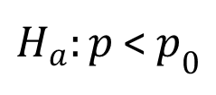
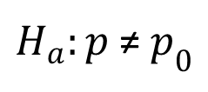
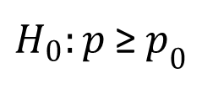
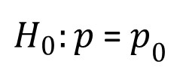
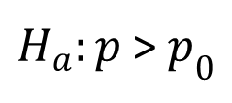
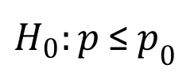
A Summary of Forms for Null and Alternative Hypotheses About a Population Proportion
The equality part of the hypotheses always appears in the null hypothesis.
In general, a hypothesis test about the value of a population proportion p must take one of the following three forms (where p₀ is the hypothesized value of the population proportion).
$H_{0}:p$≥$p_{0}$
$H_{0}:p$≤$p_{0}$
$H_{0}:p$=$p_{0}$
$H_{a}:p$<$p_{0}$
$H_{a}:p$>$p_{0}$
$H_{a}:p$≠$p_{0}$
One-tailed
(lower tail)
One-tailed
(upper tail)
Two-tailed

Slide 67
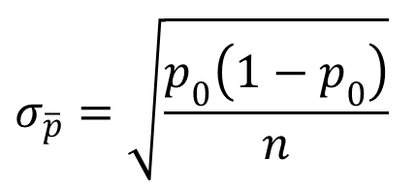
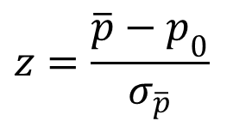
Tests About a Population Proportion
$$z=\frac{\overline{p}−p_{0}}{σ_{\overline{p}}}$$
Test Statistic:
$$σ_{\overline{p}}=\sqrt{\frac{p_{0}\left(1−p_{0}\right)}{n}}$$
where:
assuming np > 5 and n(1 – p) > 5

Slide 68
Tests About a Population Proportion
Rejection Rule: p –Value Approach
Reject H₀ if p –value < α
Rejection Rule: Critical Value Approach
H₀: p < p₀
Reject H₀ if Zcalc > Z_{α}
H₀: p > p₀
Reject H₀ if -Zcalc < -Z_{α}
H₀: p = p₀
Reject H₀ if -Zcalc < -Z_{α/2} or Zcalc > Z_{α/2}

Slide 69
Two-Tailed Test About a Population Proportion
Example: National Safety Council (NSC)
For a Christmas and New Year’s week, the National Safety Council estimated that 500 people would be killed and 25,000 injured on the nation’s roads. The NSC claimed that 50% of the accidents would be caused by drunk driving.
A sample of 120 accidents showed that 67 were caused by drunk driving. Use these data to test the NSC’s claim with α = .05.

Slide 70
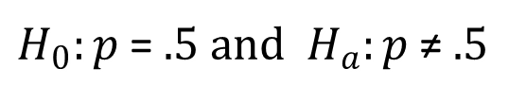
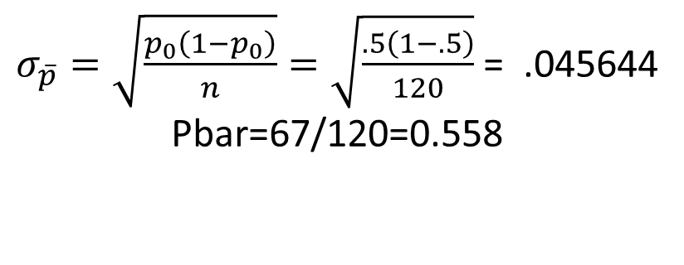
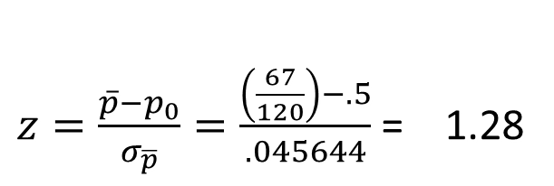
Two-Tailed Test About a Population Proportion
p –Value and Critical Value Approaches
1. Determine the hypotheses.
$H_{0}:p$=$.5 and{ H}_{a}:p \text{≠} .5$
2. Specify the level of significance.
α = .05
3. Compute the value of the test statistic.
$σ_{\overline{p}}=\sqrt{\frac{p_{0}\left(1−p_{0}\right)}{n}}=\sqrt{\frac{.5\left(1−.5\right)}{120}}$ = .045644
Pbar=67/120=0.558
$z=\frac{\overline{p}−p_{0}}{σ_{\overline{p}}}=\frac{\left(\frac{67}{120}\right)−.5}{.045644}$ = 1.28

Slide 71
Two-Tailed Test About a Population Proportion
p-Value Approach
4. Compute the p -value.
For z = 1.28, cumulative probability = .8997
p-value = 2(1 - .8997) = .2006
5. Determine whether to reject H₀.
Because p-value = .2006 > α = .05,
we cannot reject H₀.

Slide 72















Two-Tailed Test About a Population Proportion
Critical Value Approach
4. Determine the critical values and rejection rule.
For α/2 = .05/2 = .025, z_{.025} = 1.96
Reject H₀ if z < -1.96 or z > 1.96
5. Determine whether to reject H₀.
Because 1.28 < 1.96, and -1.28> -1.96
we cannot reject H₀.

Slide 73
Problems
35, 36, 38 edition page
11e 379
12e 414
13e 419
14e 447

Slide 74


















35. a.
b. Using normal table with z = -1.25: p-value = 2(.1056) = .2112
c. p-value > .05; do not reject H₀
d. z_{.025} = 1.96
Reject H₀ if z ≤ -1.96 or z ≥ 1.96
z =
1.25; do not reject H₀

Slide 75
















36. a.
Lower tail p-value is the area to the left of the test statistic
Using normal table with z = -2.80: p-value =.0026
p-value ≤ .05; Reject H₀
b.
Lower tail p-value is the area to the left of the test statistic
Using normal table with z = -1.20: p-value =.1151
p-value > .05; Do not reject H₀

Slide 76











c.
Lower tail p-value is the area to the left of the test statistic
Using normal table with z = -2.00: p-value =.0228
p-value ≤ .05; Reject H₀
d.
Lower tail p-value is the area to the left of the test statistic
Using normal table with z = .80: p-value =.7881
p-value > .05; Do not reject H₀

Slide 77
38. a. H₀: p = .64
H_{a}: p ≠ .64
b.
Because z < 0, p-value is two times the lower tail area
Using normal table with z = -2.50: p-value = 2(.0062) = .0124
c. p-value ≤ .05; reject H₀. Proportion differs from the reported .64.
d. Yes. Since
= .52, it indicates that fewer than 64% of the shoppers believe the
supermarket brand is as good as the name brand.

Slide 78
End of Chapter 9

